Slide 1
ELECTRICAL SCIENCE-1 (15B11EC111) UNIT-4 Lecture-2

Slide 2
Chapter4 Steady State Analysis of Sinusoid

Slide 3
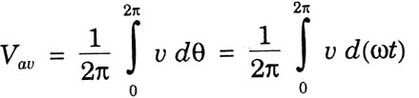
Different Values of AC
Average (or Mean) Value : It is the arithmetic sum of all the values divided by the total number of values.
Average Value of AC : It is equivalent direct current, which transfers the same charge as transferred by that ac current in the same time.
Next

Slide 4
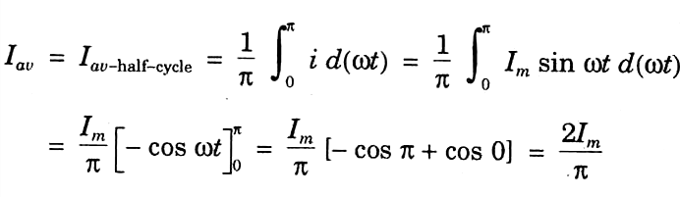
Average of a sine wave
The average of a sine wave over a full cycle is zero.
But average value of half-cycle only.
Next

Slide 5
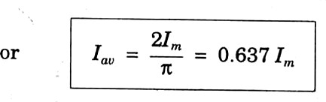
Next

Slide 6
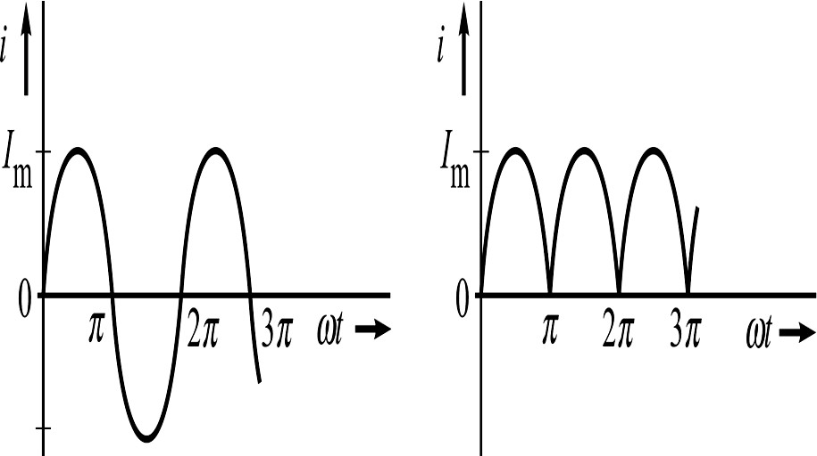
Following two waves have the same average value.
(a) Sinusoidal ac current.
(b) Full-wave rectified current.
Next

Slide 7
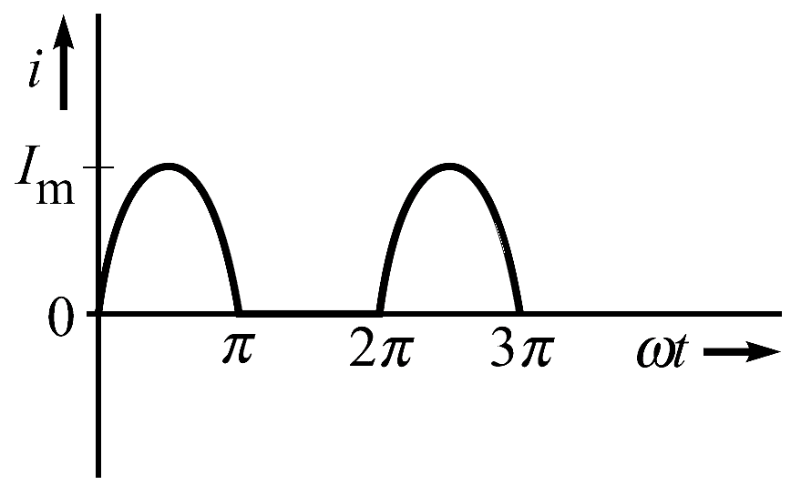
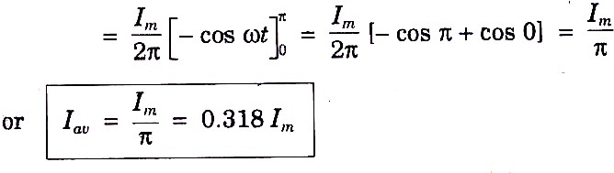
Output of half-wave Rectifier
The average value is given as
Next

Slide 8
It is obvious that the average value of half-wave rectified current is just half of the average of full- wave rectified current.
Next

Slide 9
RMS or Effective Value
It is equivalent dc current, which when flows through the given circuit produces same amount of heating.
Let us try to find the waveform of instantaneous power in a resistor due to an ac current.
Next

Slide 10
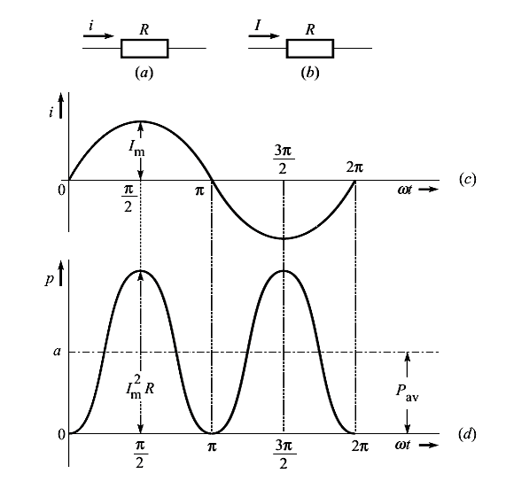
Instantaneous Power
Next

Slide 11
Important Factors
Form Factor : It is the ratio of rms value to the average value of an alternating quantity.
₌ ^{I}rms
K
= 1.11 forsinusoidal.
f
I
av
Form factor has less value for less peaky wave. For square wave it is 1.0, for triangular wave it is 1.15.
Next

Slide 12
Peak (or Amplitude ) Factor : It is the ratio of maximum value to the rms value.
₌ I_{m}
K
=1.414 forsinusoidal.
p
I
rms
Next

Slide 13
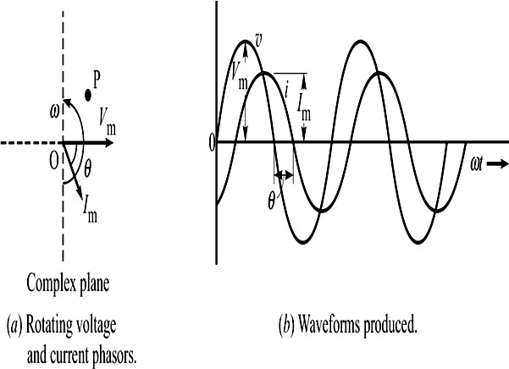
Concept of Phasors
The rotating bar that generates a sinusoid can be taken as a phasor.
The phasor V_{m} is in reference direction, but phasor I_{m} lags behind V_{m} by θ.
Next

Slide 14
Thus, we can write,
v(t) = V_{m} sin ωt and i(t) = I_{m} sin (ωt −θ )
Phasor Diagram : It is a diagram containing
the phasors of inter-related sinusoidal voltages and currents, with their phase differences indicated,
It can be drawn either in terms of peak values or rms values.
Note that the phase of two sine waves can be compared only if
Both have the same frequency.
Both are written with positive amplitude.
Both are written as sine functions, or as cosine functions.
Next

Slide 15
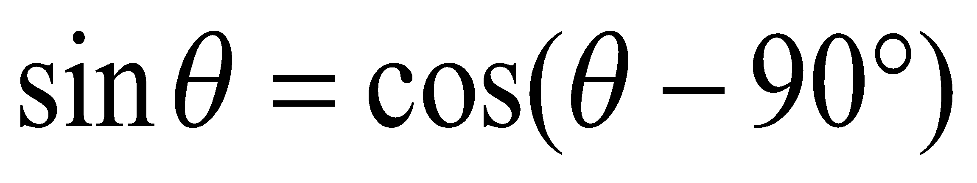
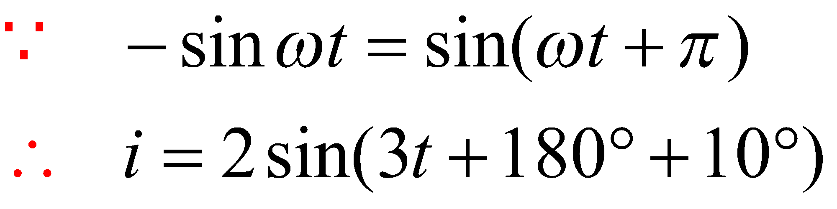
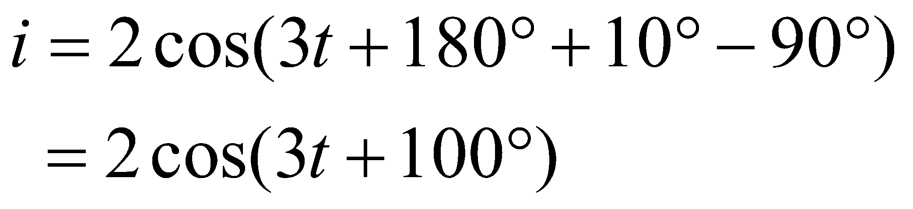
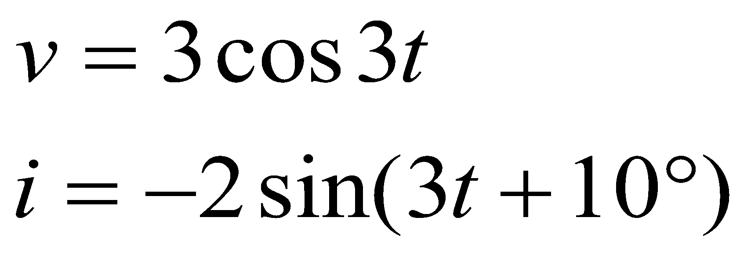

Example1
Find their phase relationship
and
Therefore current leads with voltage by

Slide 16
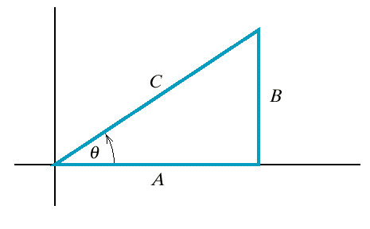
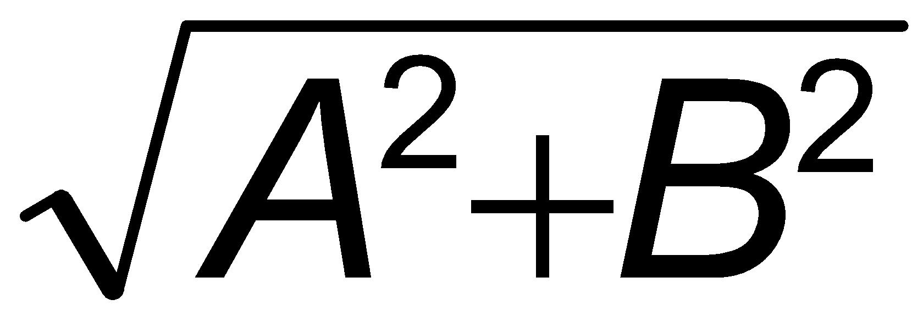
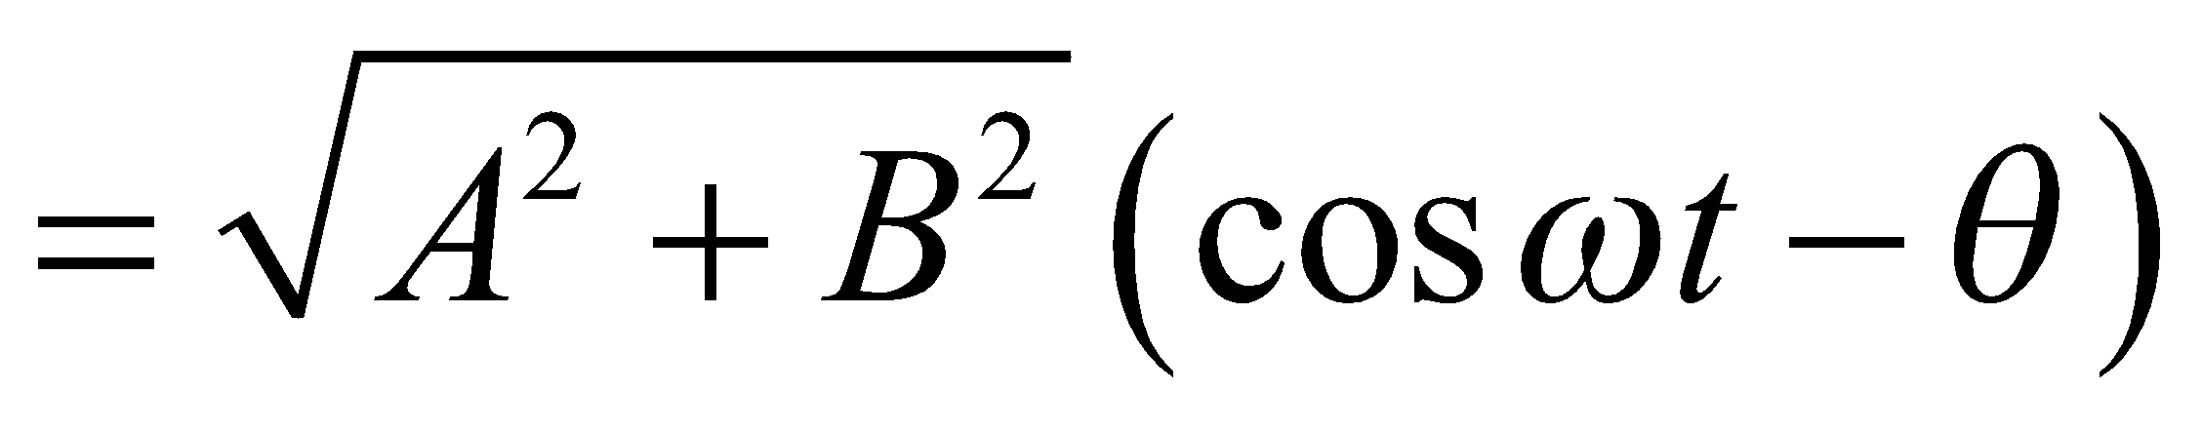
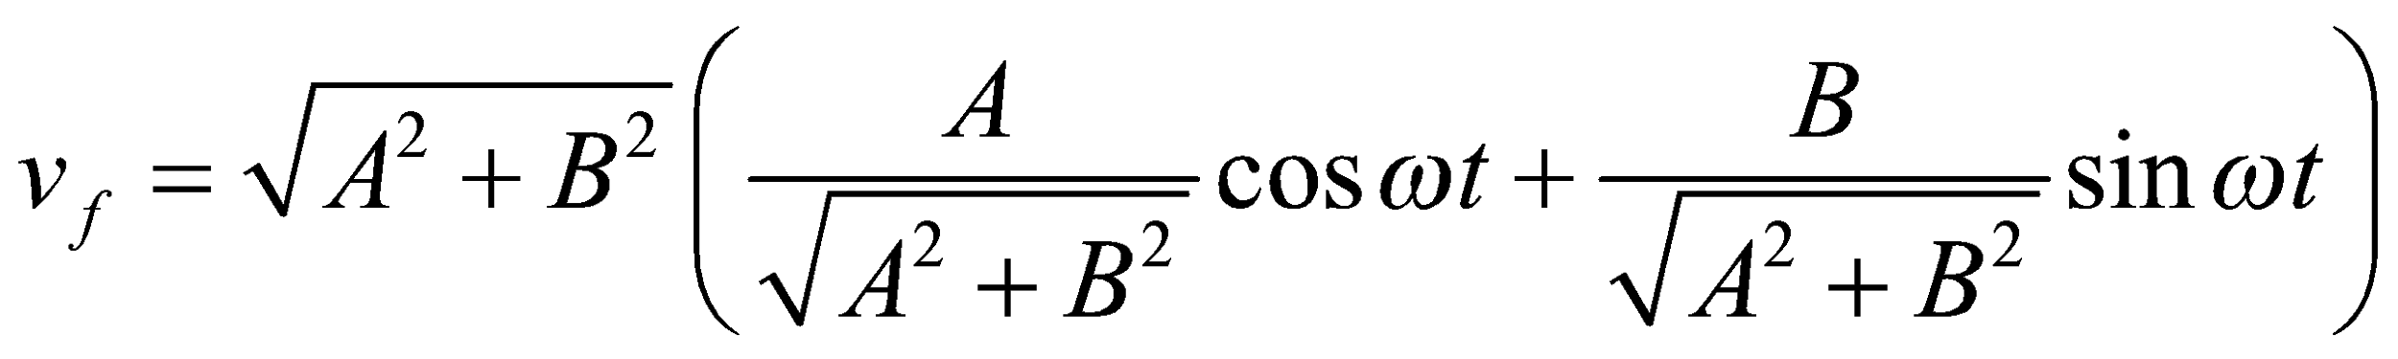
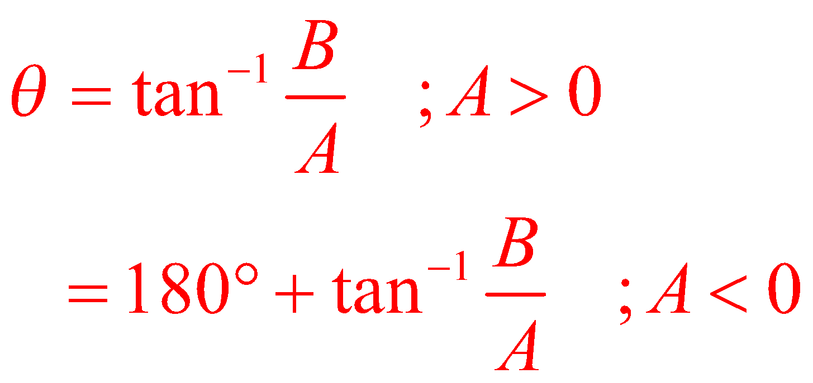
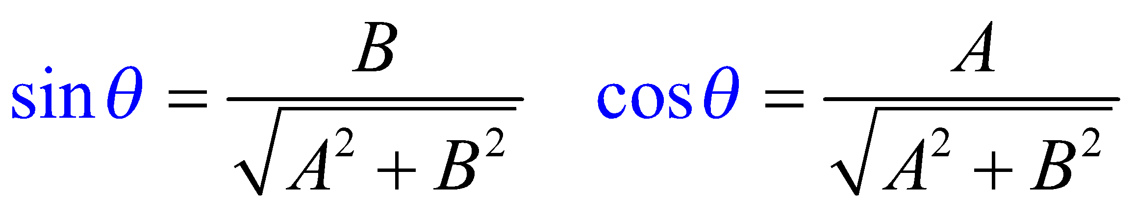
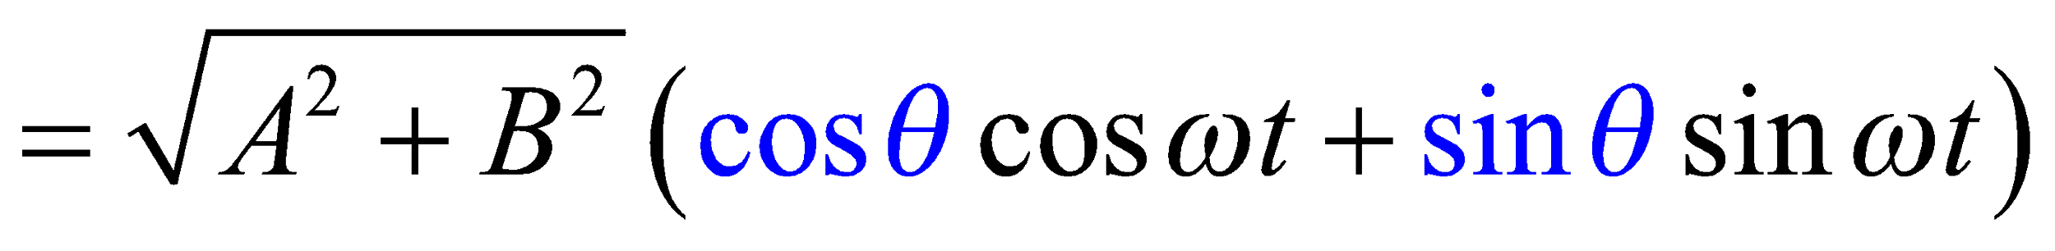
Recall
Triangle for A and B of Eq. 10.3-4,
where C = .

Slide 17
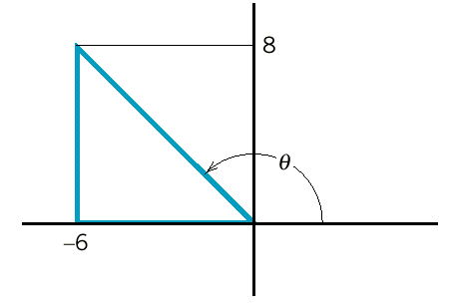
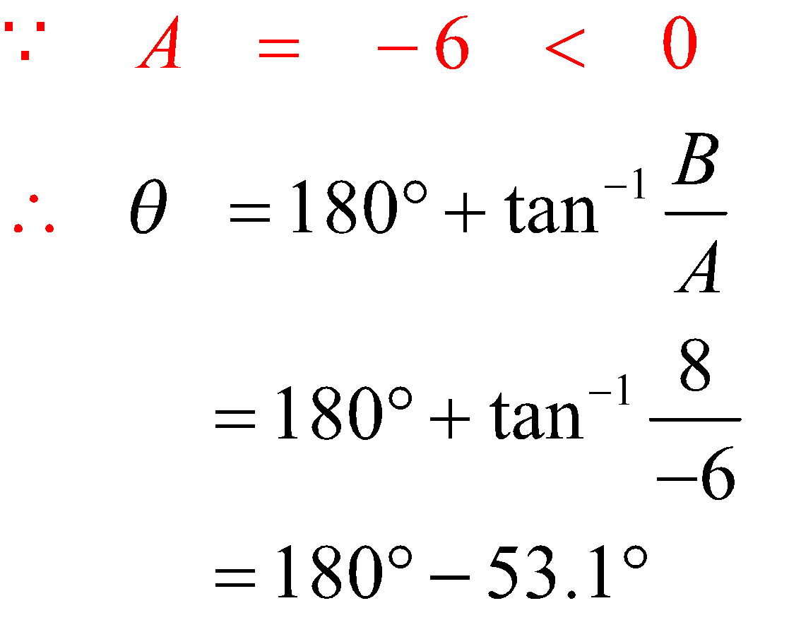
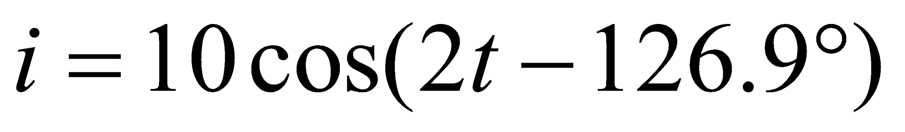
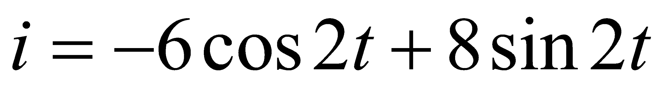
Example 10.3-2
A
B
B
A

Slide 18
References
R.C. Dorf and James A. Svoboda, “Introduction to Electric Circuits”, 9th ed, John Wiley & Sons, 2013.
D.C. Kulshreshtha, Basic Electrical Engineering, Revised 1st ed, Tata Mc Graw Hill, 2017.
V. K.Mehta, Rohit Mehta, Basic Electrical Engineering, 6th ed, S. Chand Publishing, 2012.

Slide 19
Thanks

